Slide 1
Final Report Capstone Project Battle of Neighborhoods - Finding New Place to Stay at Toronto, Canada
Setiawan

Slide 2
Introduction
Finding new place to stay is hard.
Several parameters that need to be considered:
house prices
crime rate
population density
nearby venues
Toronto's Neighborhoods are clustered based on the parameters above and the best neighborhoods will be chosen.
The results of this project are used to narrow the options of neighborhood in Toronto to stay at.

Slide 3
Business Problem
Potential Buyer
Reducing the number of neighborhood options is important because it helps them to reduce the time and effort needed to look into the neighborhood one by one.
Real Estate Agent
Reducing the number of neighborhood options is important because they can focus to promote certain neighborhoods to their potential buyers (or renters).

Slide 4
Data
Several parameters that are used in this study to narrow down the Toronto's neighborhood options are:
House price (https://www.zolo.ca/toronto-real-estate/neighborhoods.)
Crime rate and Population Density (https://opendata.arcgis.com/datasets/af500b5abb7240399853b35a2362d0c0_0.csv?outSR=%7B%22latestWkid%22%3A26717%2C%22wkid%22%3A26717%7D)
Nearby venues (https://foursquare.com/)

Slide 5
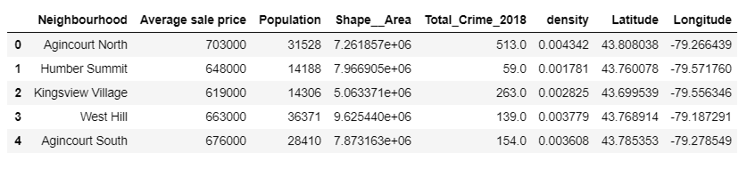
Data
The figure above is the snapped figure of top 5 data frame after it has been cleaned.

Slide 6
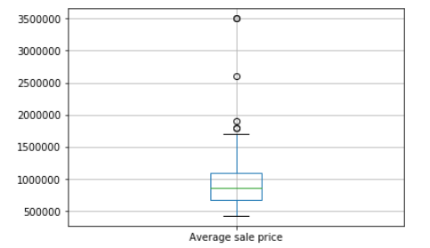
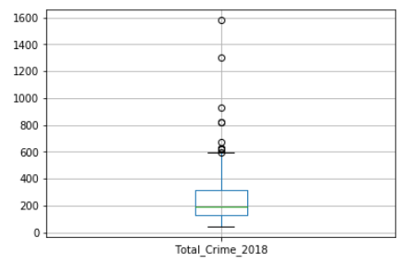
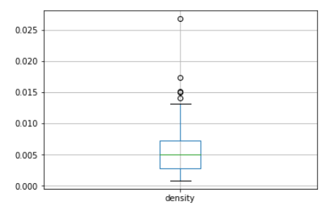
Exploratory data analysis Boxplot
The distributions are right skewed distribution with outliers on the right side of the data.
Outliers are removed from the data to better visualize the data in the scatter plot.

Slide 7
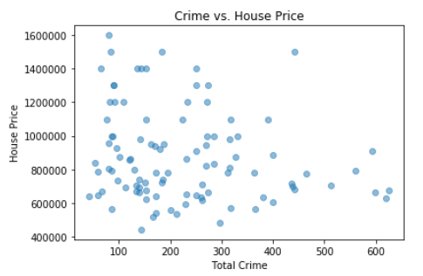
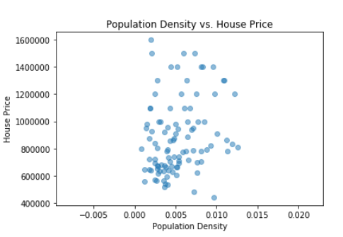
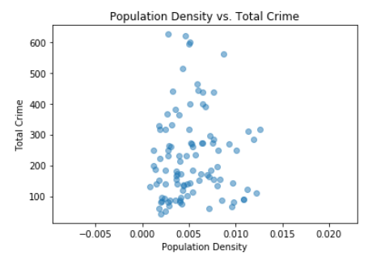
Exploratory data analysis Scatter Plots
There is no clear correlation between the variables.

Slide 8
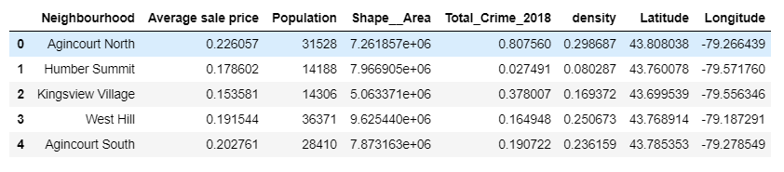
Clustering Analysis I Normalize Data
The data is normalized because the scales of the variables are incomparable.
Conducting machine learning analysis immediately without normalizing the data may heavily be affected by the house price variable.

Slide 9
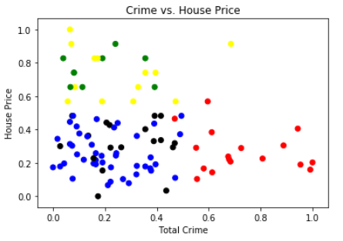
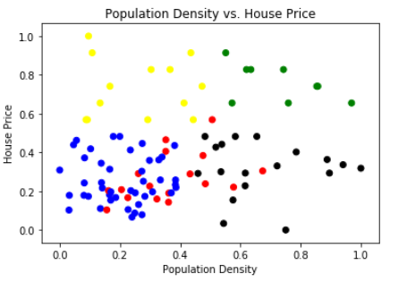
Clustering Analysis I K-Means Clustering
5 clusters
Low price, low crime rate, and low population density = Blue Dots
Low price, low crime rate, and high population density = Black Dots

Slide 10
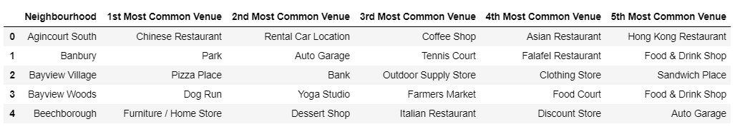
Finding the nearby venues for chosen neighborhoods
Foursquare API is used to find nearby venues for the chosen neighborhoods.
500 meters radius from the location data of each neighborhood.
Top 5 venues are chosen.

Slide 11
Clustering Analysis II
5 clusters
First Cluster – Park
Second Cluster – Fast food Restaurants
Third Cluster – Non-American Restaurants
Fourth Cluster – Playground
Fifth Cluster – Dog Run

Slide 12
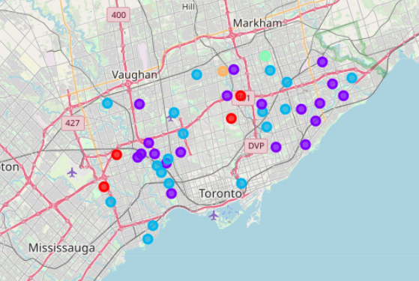
Result and Discussion
First Cluster – Red Dots
Second Cluster – Purple Dots
Third Cluster – Light blue dots
Fourth Cluster – Light green dots
Fifth Cluster – Yellow dots

Slide 13
Result and Discussion
From the results of the first clustering, which is based on house price, crime rate, and population density, we can determine the neighborhoods with low house price, low crime rate and low population density.
We can also determine low house price, low crime rate and high population density.
The second clustering is done with 5 clusters.

Slide 14
Result and Discussion First Cluster
Kingsview Village
Banbury
Eringate
Henry Farm
The first cluster most common venue is park.
The neighborhoods in this cluster are suitable for people who enjoy outdoor activities especially when the weather is nice.

Slide 15
Result and Discussion Second Cluster
West Hill | Bendale
Keelesdale | Cliffside
Bayview Village | Briar Hill
Elms | Clairlea
Brookhaven | Eglinton East
York University Heights | High Park
Morningside | Parkwoods
Weston | Rustic
Hillcrest Village | Woburn
Malvern
The second cluster most common venue is fast food restaurants.
The neighborhoods in this cluster are suitable for people who like to order fastfood probably because they are busy.

Slide 16
Result and Discussion Third Cluster
Humber Summit | Highland Creek
Agincourt South | Junction Area
L'Amoreaux | Mimico
Newtonbrook West | Mount Dennis
Yorkdale | New Toronto
Etobicoke West Mall | O'Connor
West Humber | South Riverdale
Beechborough | Victoria Village
Dorset Park
Downsview
The third cluster most common venue is Non-American restaurant.
The neighborhoods in this cluster are suitable for people who enjoy non-american foods such as Asian, Mexican, Italian, Middle Eastern foods.

Slide 17
Result and Discussion Forth and Fifth Cluster
Fourth Cluster | Fifth Cluster
Steeles | Bayview Woods
The fourth cluster's neighborhood most common venue is playground which is suitable for families that have kids.
The fifth cluster's neighborhood most common venue is dog run, which is suitable for people who own dogs.

Slide 18
Conclusion
Toronto has around 140 neighborhoods and it is hard to find the best place to move to.
To narrow down the options, we use house price, crime rate, population density, and nearby venues data.
Clustering analysis is done using house price, crime rate, population density data.
Foursquare API is used to find top 5 most common venue within 500 meters.
The first cluster contains park as the most common place with is suitable for people who enjoy outdoor activities, the second cluster's most common venue is fastfood restaurants, the third cluster's most common venue is Non-American restaurant, the fourth and fifth cluster's most common venues are playground and dog run respectively.

Slide 19
Conclusion
Depending on preferences, one can choose to look into neighborhoods in preferred nearby venues.
Caution needs to be applied when looking into the Neighborhood because the analysis done in this study is simplified.
It is best for everyone who wants to move to a certain neighborhood to directly visit the neighborhood to directly experience the living condition there.

